Slide 1
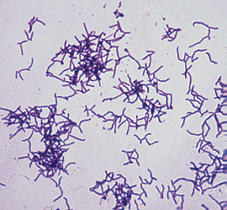
Actinomyces
Members of the genus Actinomyces are G+, non-acid fast, non-spore forming rods. They are facultatively anaerobic. Actinomyces species grow poorly on Sabouraud’s dextrose agar, a characteristic that differentiate them from Nocardia & streptomyces. Most species in the genus produce true mycelium & angular branching is common. They are non-motile.
The species most often associated with disease in domestic animals are:
Actinomyces bovis
Actinomyces viscosus
Actinomyces suis
Actinomyces israelii causing an important disease in human

Slide 2
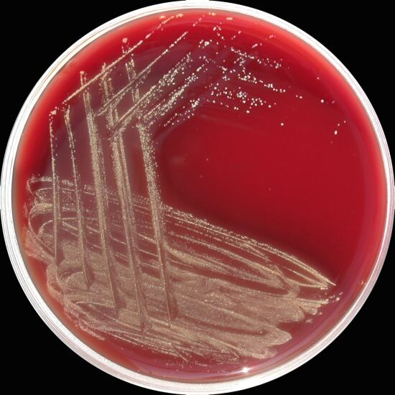
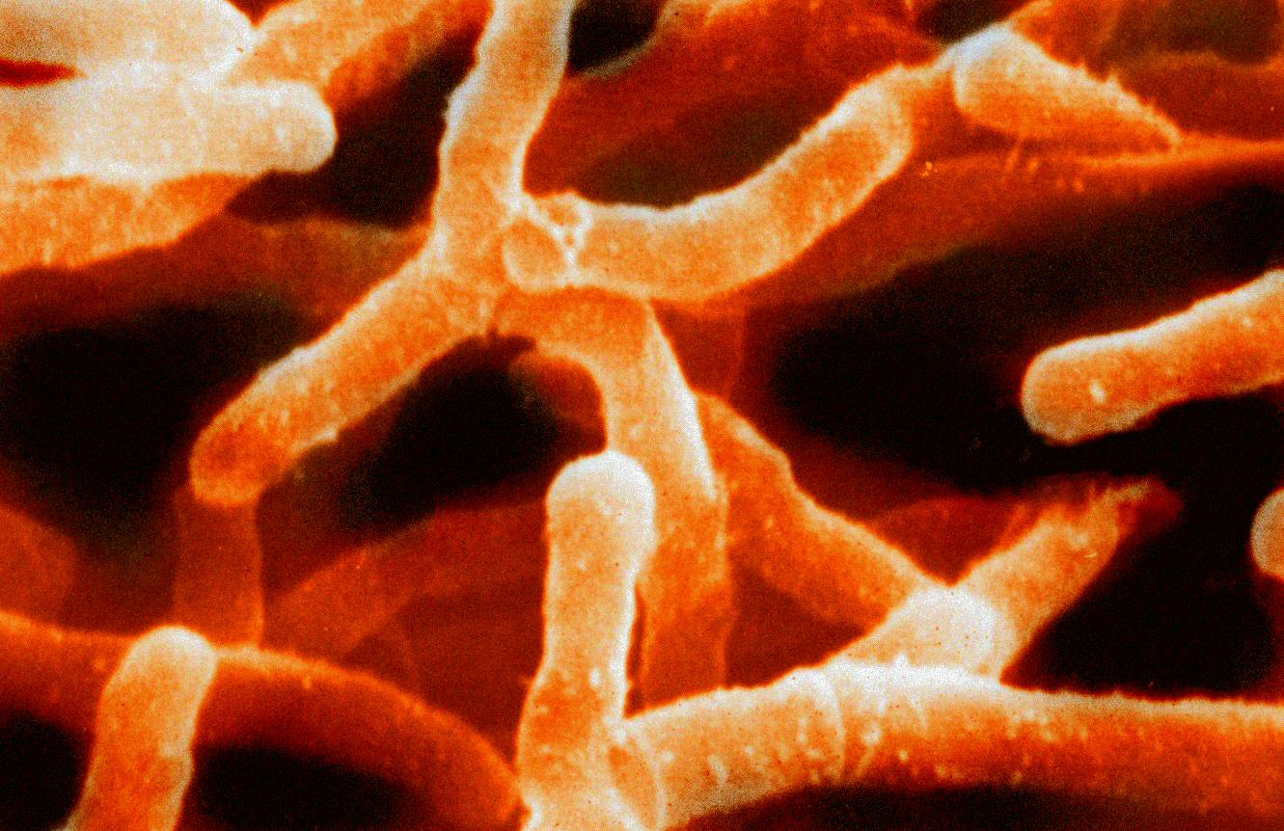
Actinomyces on blood agar, branching Actinomyces

Slide 3
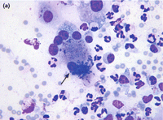
Disease & pathogenesis
A.bovis causes actinomycosis or lumpy jaw in cattle (produce similar infection in humans). Bovine actinomycosis usually affects bony structures, and is most commonly seen in the mandible, or lower jaw. Pulmonary infections may occur in cattle & swine. The disease has been reported in other ruminants, and dogs often develop actinomycotic spondilitis. Actinomycosis can also occurs concurrently with lung adenocarcinoma in dogs.
A.bovis is a normal resident of bovine oropharyngeal & digestive tract tissues. It gain access to deeper tissues of the jaw by way of dental alveoli or through mucous damaged by rough feed or foreign bodies. Mandibular granulation & chronic osteomylitis follow. Suppurative necrosis can occur in the esophagus & reticulum & thick green to yellow pus move to the surface by fistulous tracts. Palpable masses can be found in soft tissues. Macrocolonies of A. bovis often called sulfur granules are found in pus.

Slide 4
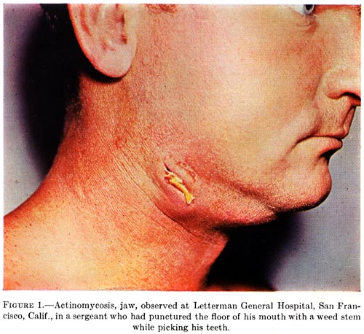
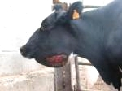
A. bovis infection (lumpy jaw) in human & cattle

Slide 5
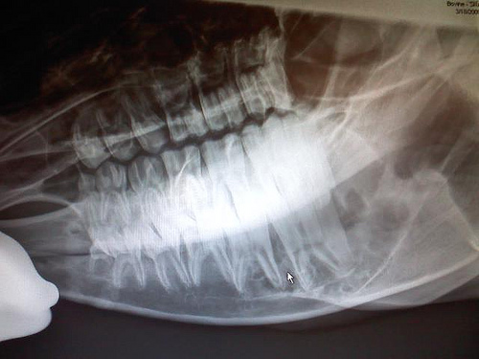
Disease & pathogenesis
Pyogranulomatous response is the hallmark of infection by A.bovius. The area of suppuration is surrounded by granulation, fibrosis & mononuclear cell infiltration. Bone honeycombed with pus-filled sinus tracts replaces normal bone. Affacted animal may lose teeth & become unable to chew & develop mandibular fractures. Circulating Abs develop after infection, but it dose not limit the infection, & it is likely that resistance is cell mediated.
A. vicosus infection in dogs manifest as cutaneous nodulo-ulcertative lymphangitis. The normal habitat of A. viscosus is likely the same as in A.bovis. A. viscosus is commonly associated with thoracic infections in dogs.
A. suis is frequently recovered from opportunistic mammary infection in sows.

Slide 6
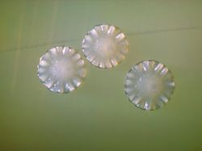
Diagnosis
Actinomyces can usually demonstrated in the sulfur granules associated with draining lesion. Colonies surrounded by a border of club-like structures (Called rosettes). Definitive differentiation can usually be accomplished by examination of the Gram stain & colonial morphology. Granules (not pus) should be washed & crushed under coverslip & examine. In such preparation, A.bovis appears as of filaments with acidophilic capsule, & the filaments as Gram + & basophilic. Diverse forms can be seen in crushed granules (cocci, pleomorphic & branched rods). In vitro, A. bovis usually take the diphtheroid forms.
Like other animal actinomyces, A.bovis require rich media with serum or blood. Growth is evident after 48-72 hrs. The organism is non-hemolytic. It produces flat, smooth-to-granular (molar tooth colonies).
A.viscosus is catalase + that differentiate it from other members of the genus.

